Slide 1
Find Edge Library
Aneesh Batchu
Aug 23rd, 2024
Team: Aleksandar, Jiabao and Aneesh

Slide 2
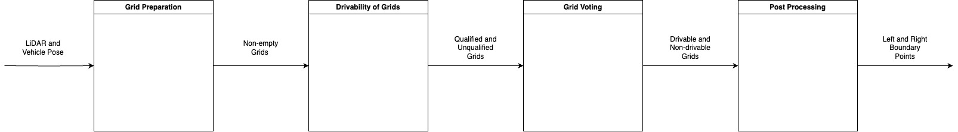
Goal: Convert 3D lidar points into the calculation of the road edge. The BIG PICTURE of the process is shown below
Right Boundary Points = Road Edge
Road edge: The edge of the pavement and the vegetation next to the road.

Slide 3
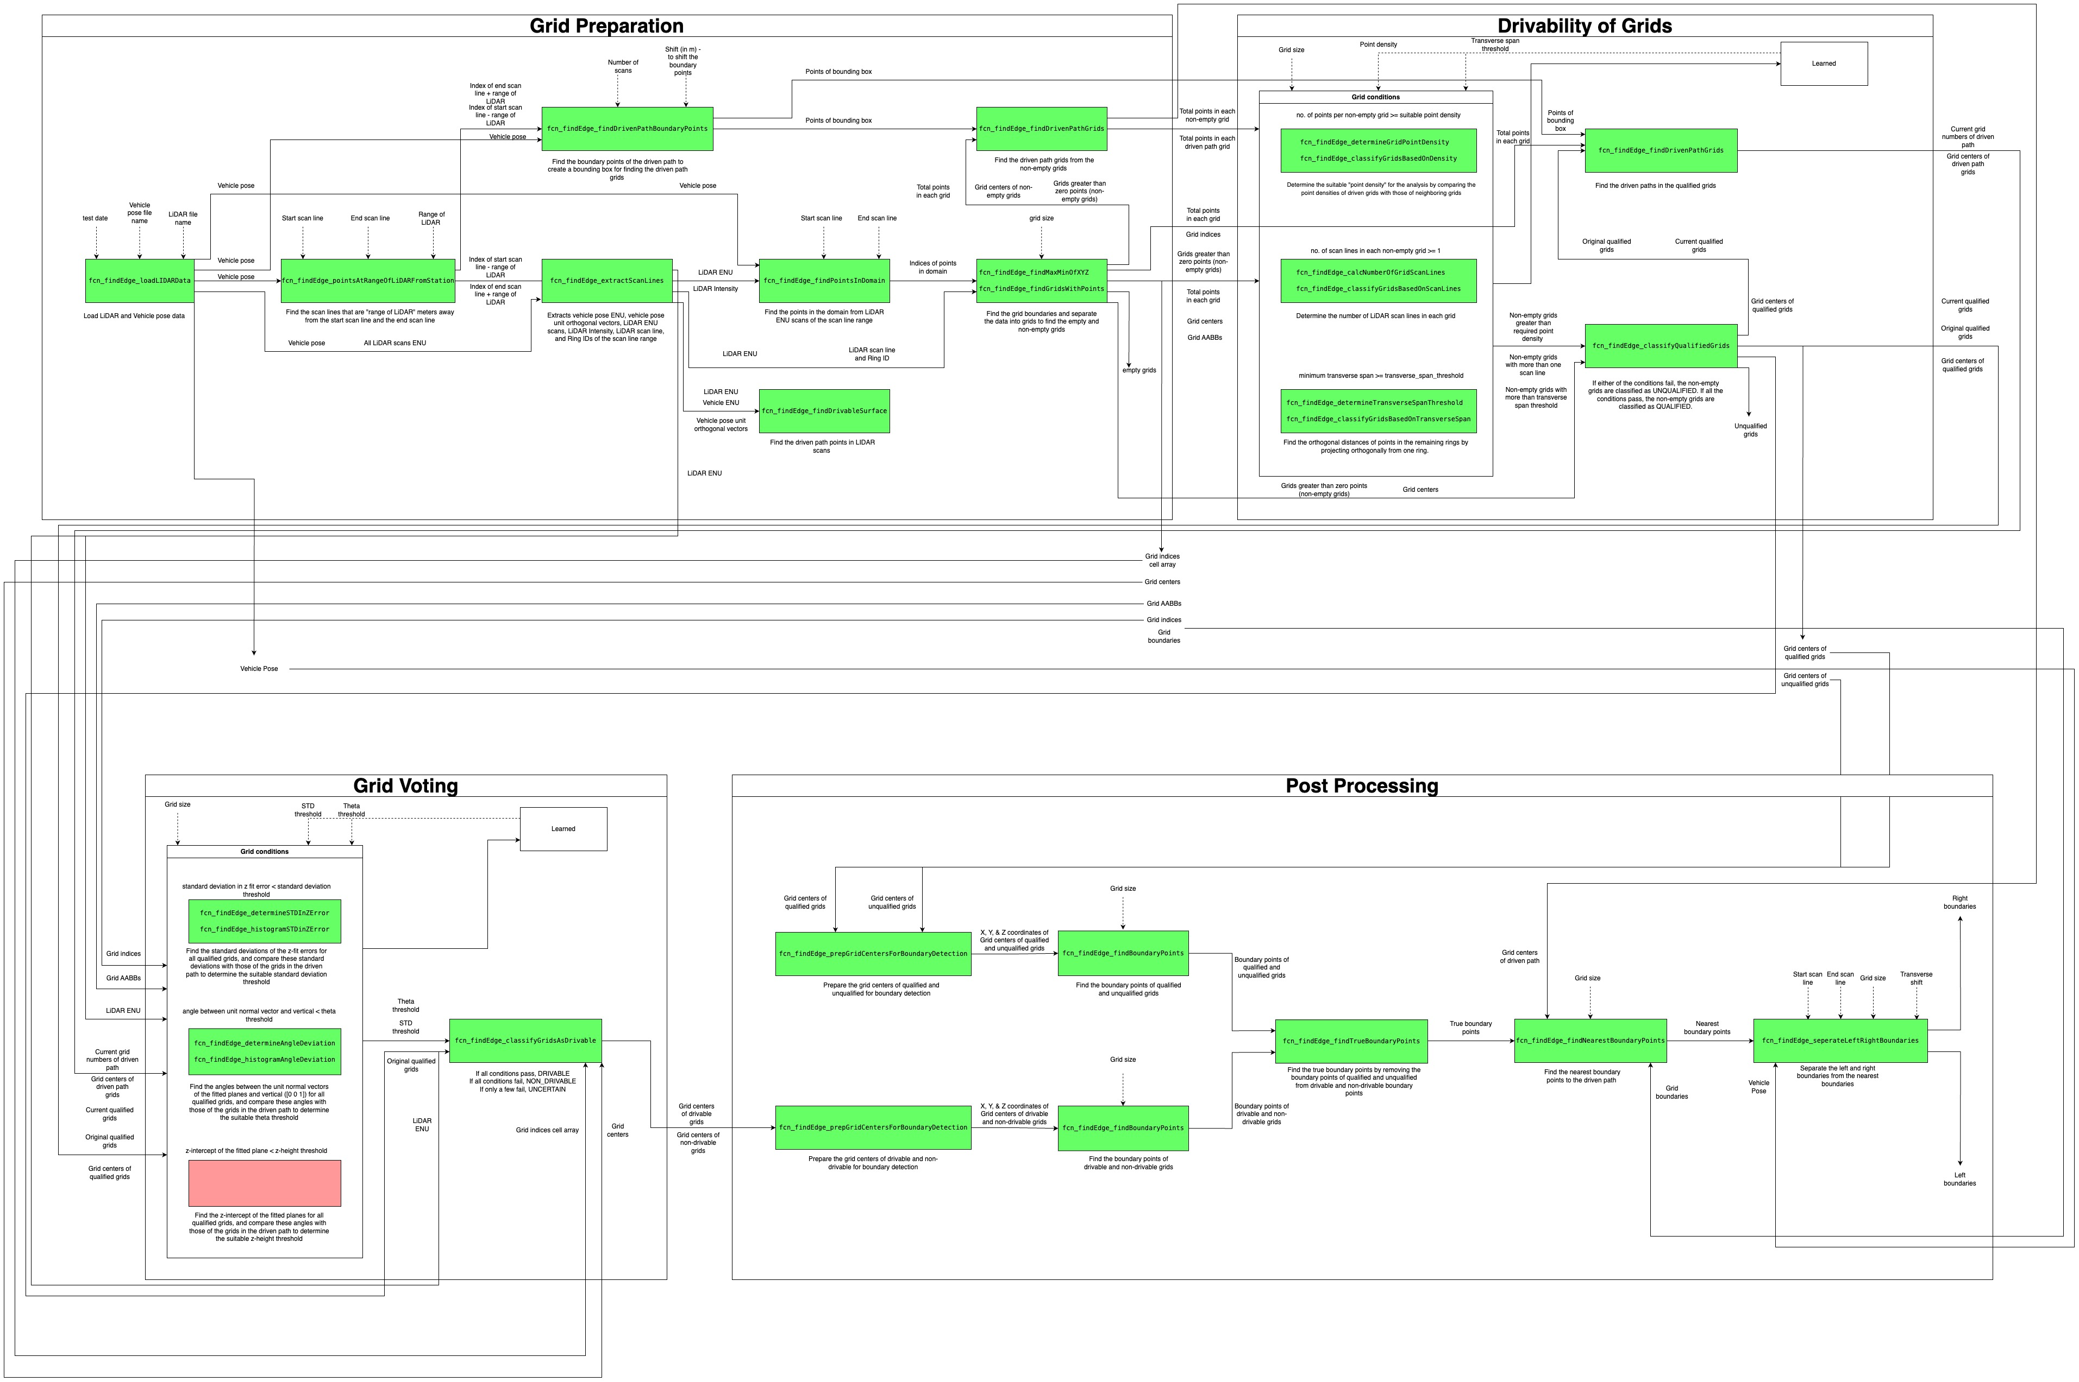
Overview

Slide 4
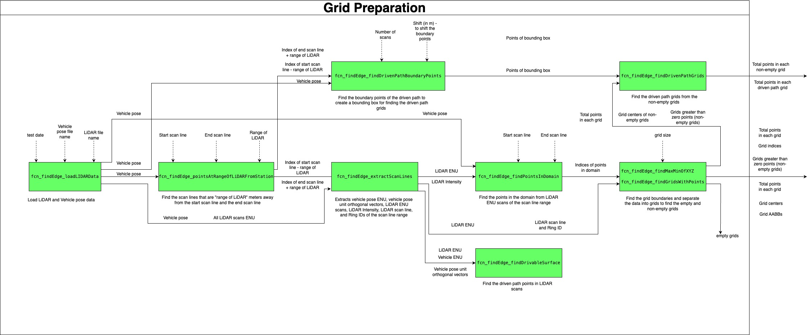
Grid Preparation

Slide 5
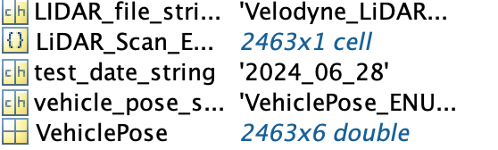
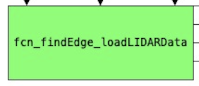
Load LiDAR and Vehicle Pose Data

Slide 6
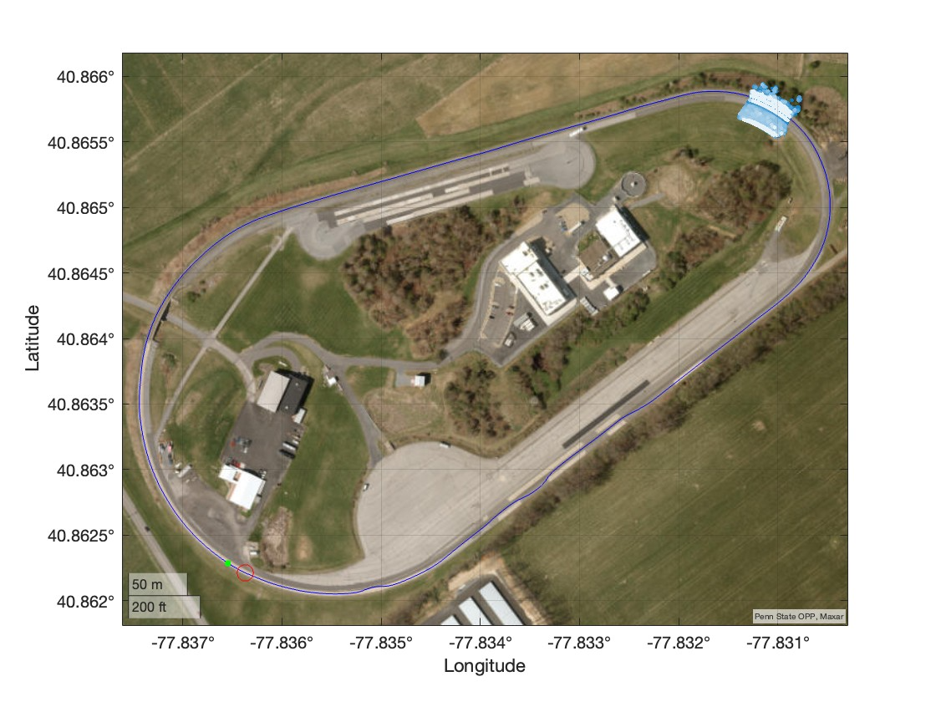
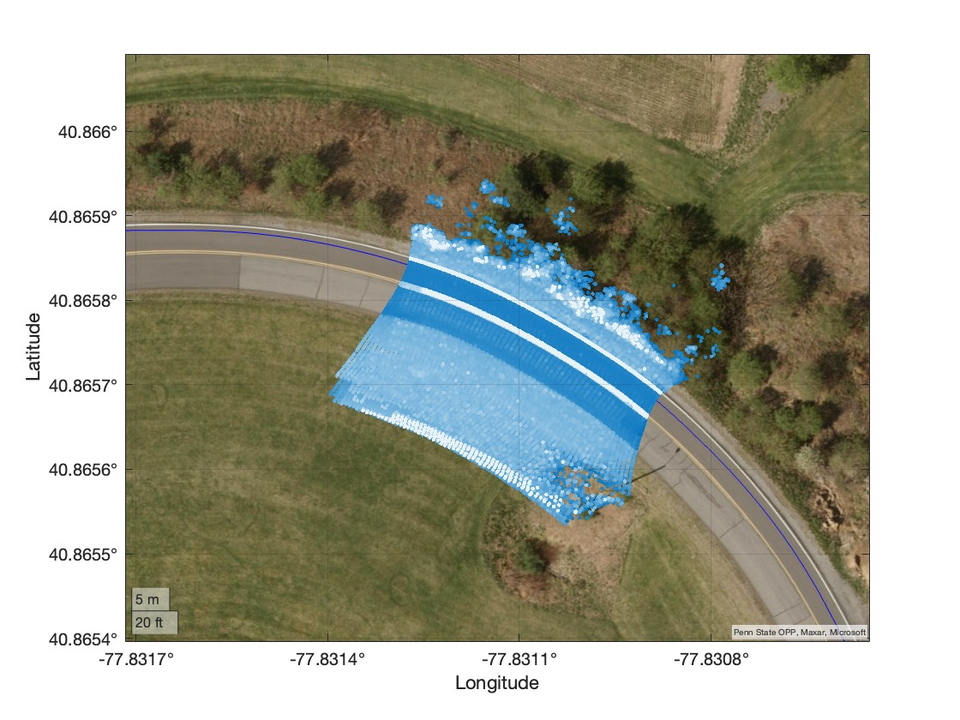
LiDAR scan lines [1400 - 1450] are plotted on a geo plot. The RHS plot is the zoomed-in plot of the LHS

Slide 7
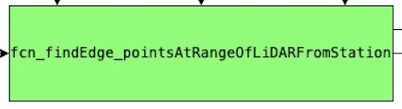
The scan lines that are "range of LiDAR" meters away from the start scan line and the end scan line are computed

Slide 8
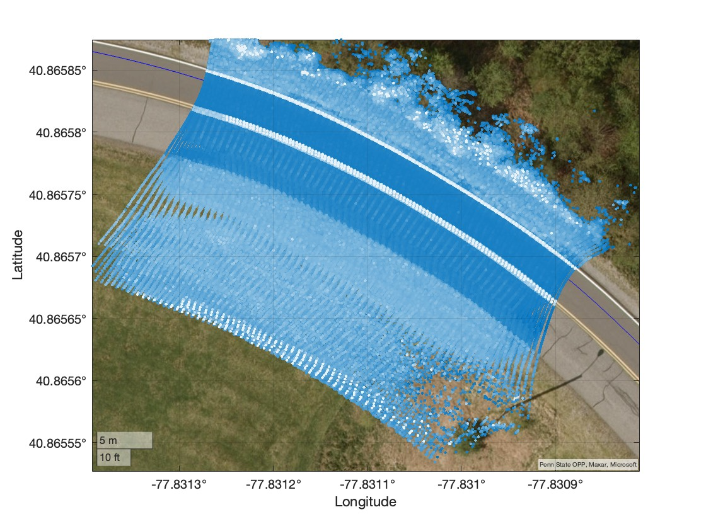
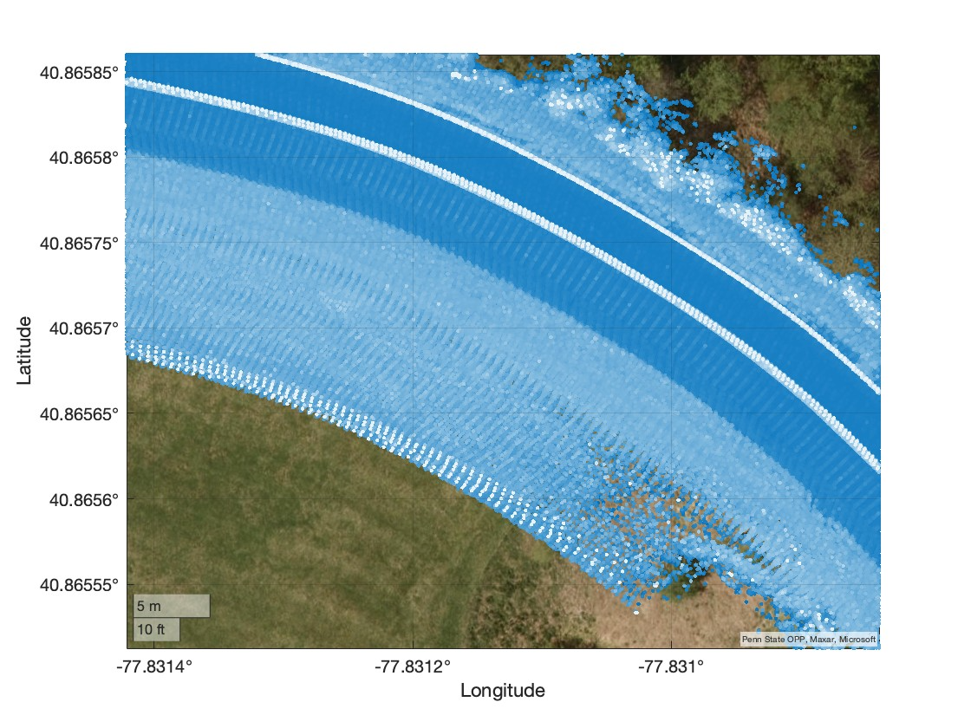
The gaps in the LiDAR scans (1400-1450) (LHS) indicate that insufficient data was captured. To address this, the indices of the scan lines that are 100 meters (the range of LiDAR) before the start scan line (1400) and 100 meters after the end scan line (1450) were determined by computing the distances of the scan lines from each station.

Slide 9
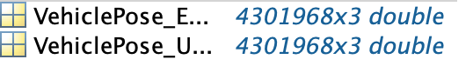
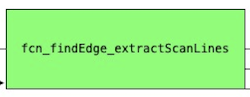
Extract the vehicle pose ENU, vehicle pose unit orthogonal vectors, LiDAR ENU scans, LiDAR Intensity, LiDAR scan line, and Ring IDs of the scan line range ([1245 1616])

Slide 10
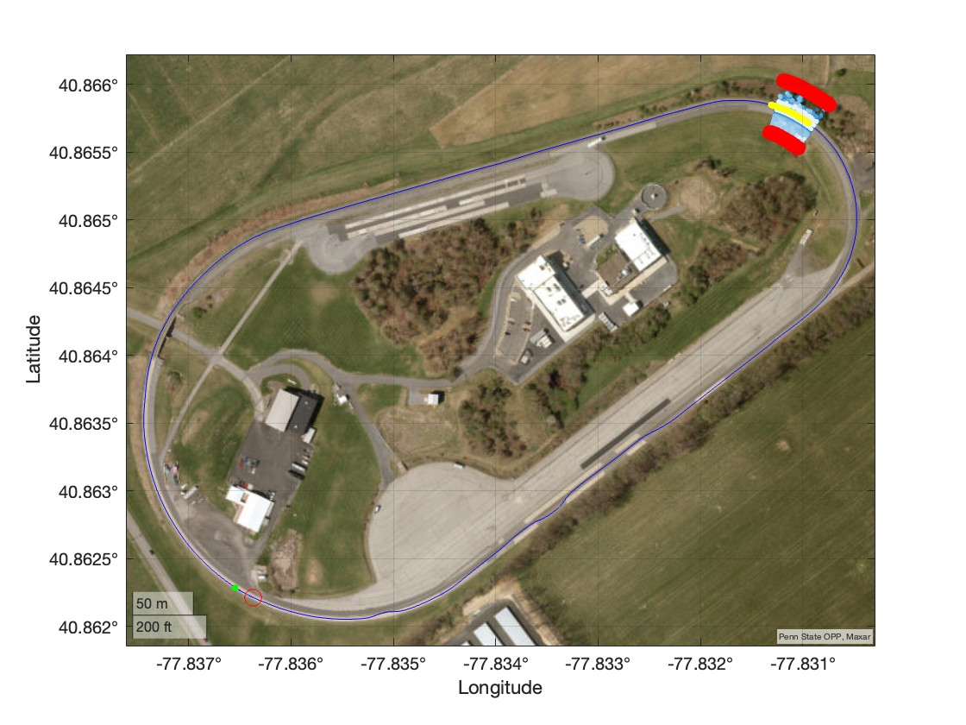
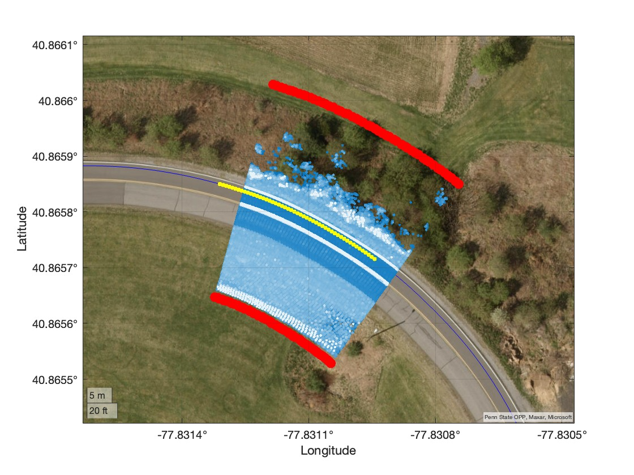
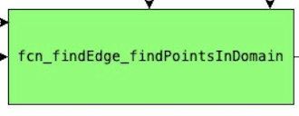
The points in the domain are selected by extending the orthogonal vector of the change in the XY position of the vehicle by 22 m (six times lane width). All the points within these boundaries (red points) are considered to be in the domain.

Slide 11
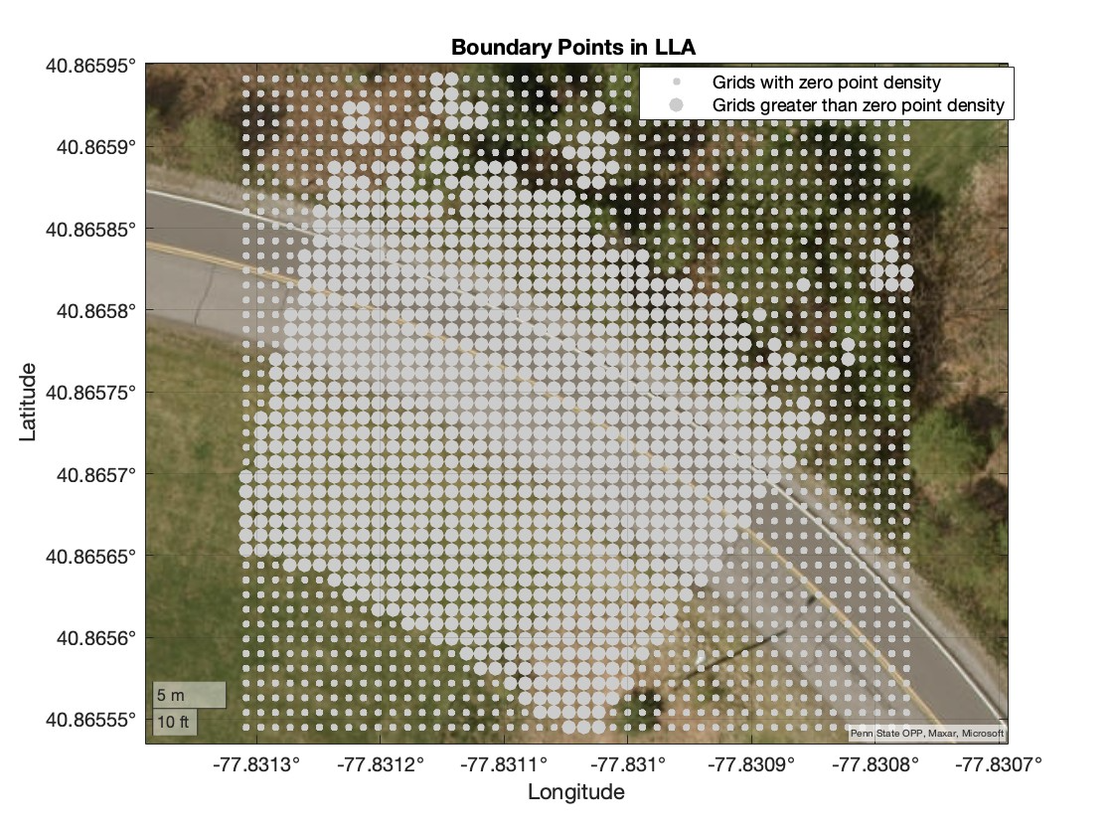
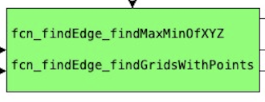
LiDAR data is segmented into grids to classify them into those with zero points and those with more than zero points (non-empty grids). The grids with zero points (empty grids) are then dropped from the further analysis.

Slide 12
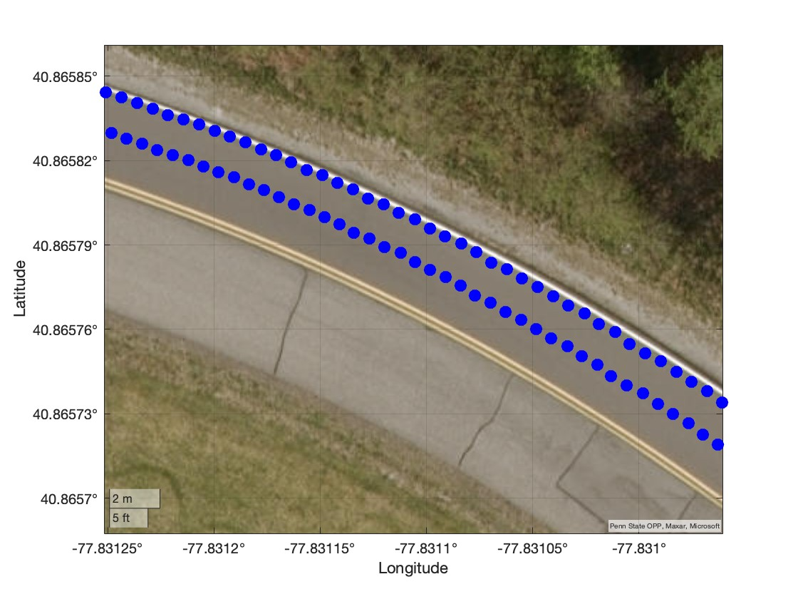
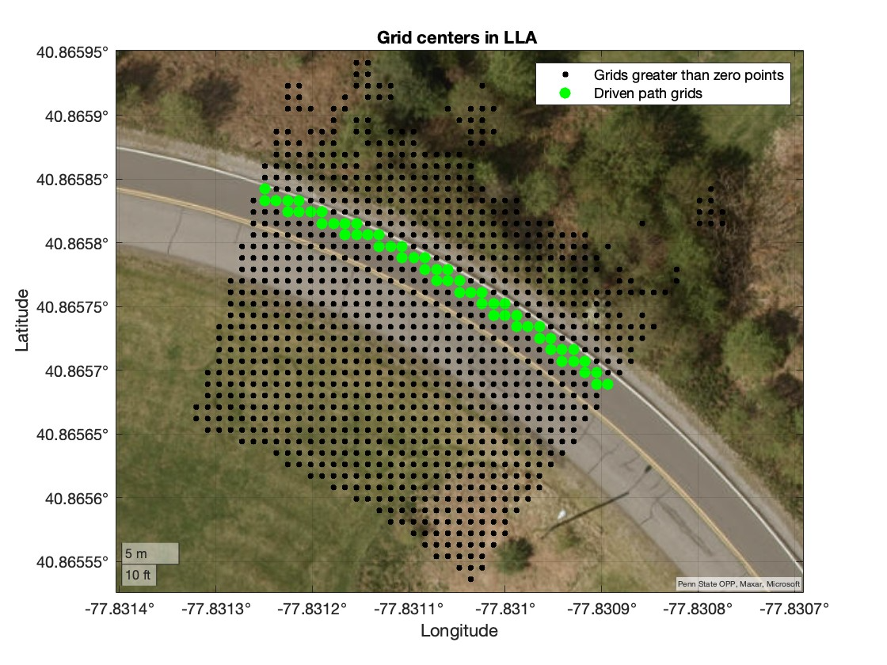
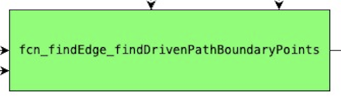
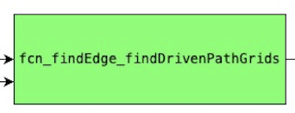
The boundary points (LHS) of the driven path are computed to create a bounding box for finding the driven path grids. The RHS plot has the driven path grids

Slide 13
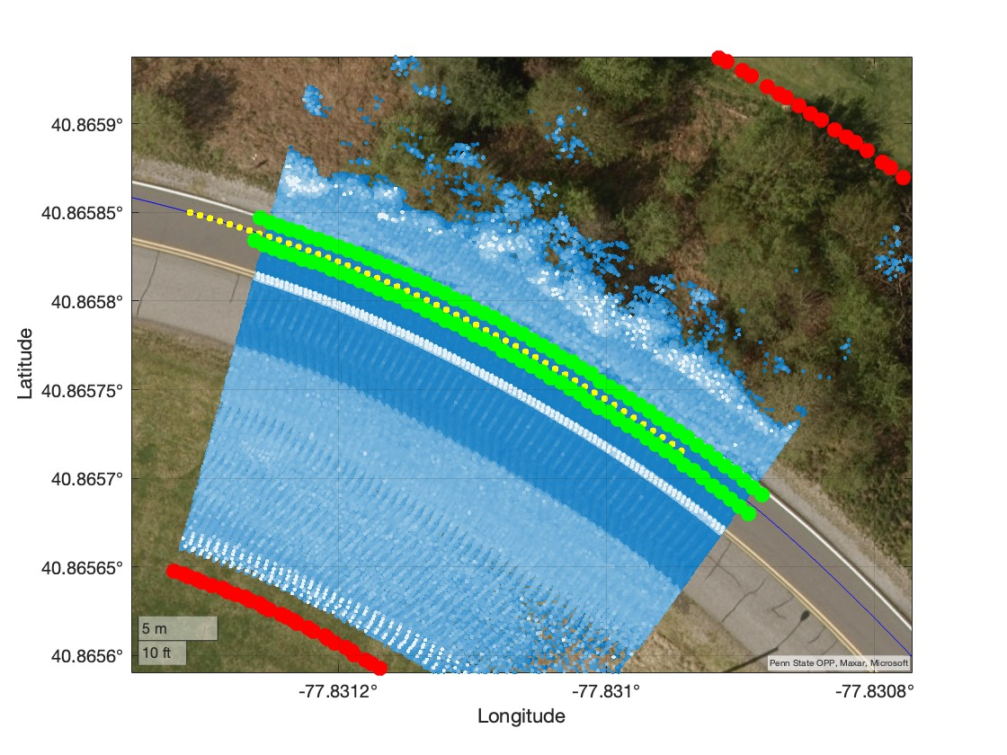
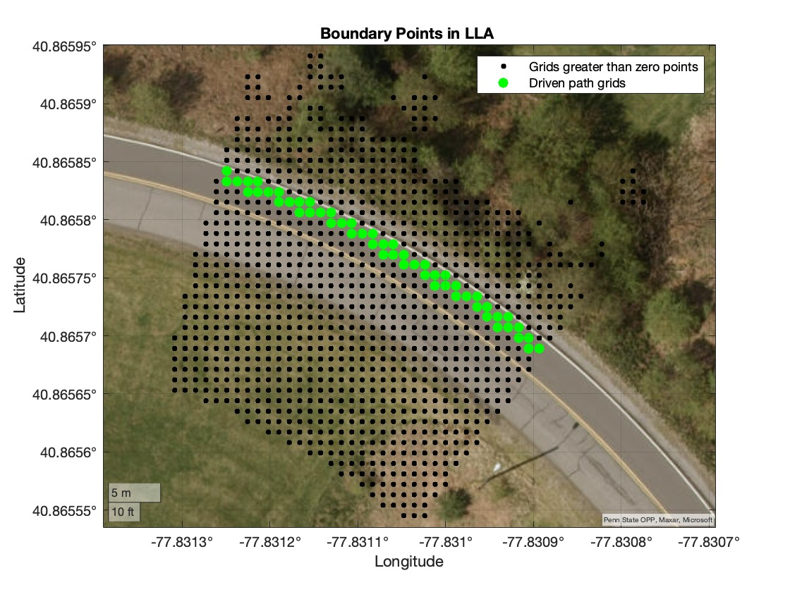
The boundary points of the driven path are computed by extending the unit orthogonal vectors of the vehicle's position to determine the driven path grids. The driven path grids are plotted in the RHS plot.

Slide 14
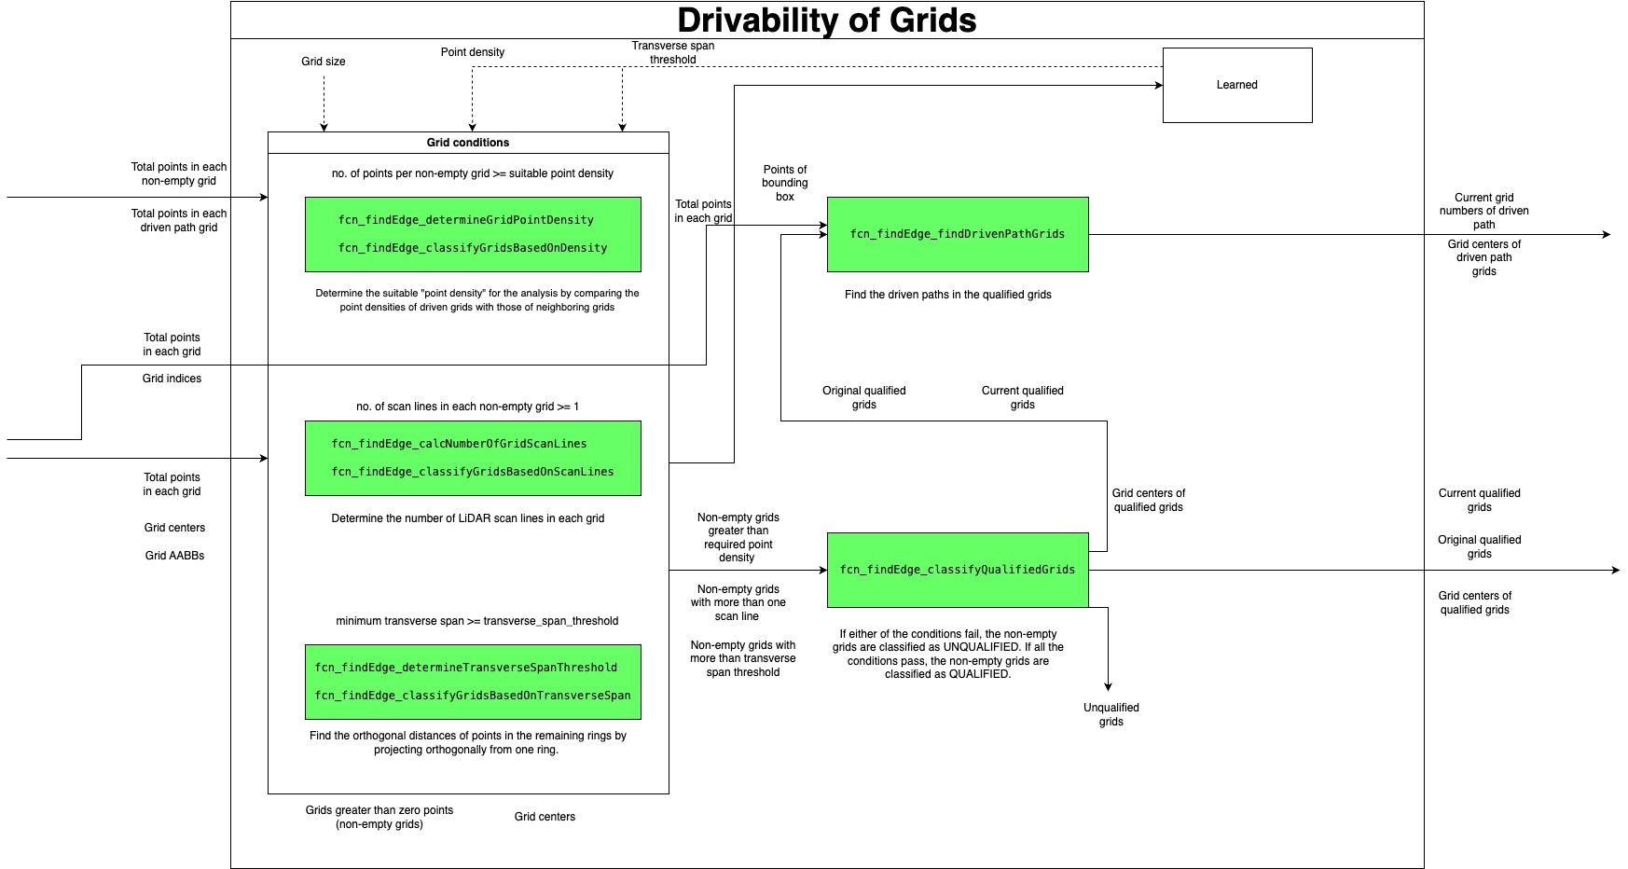
Drivability of Grids

Slide 15
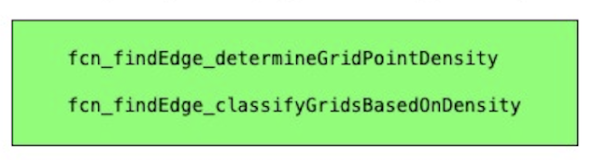
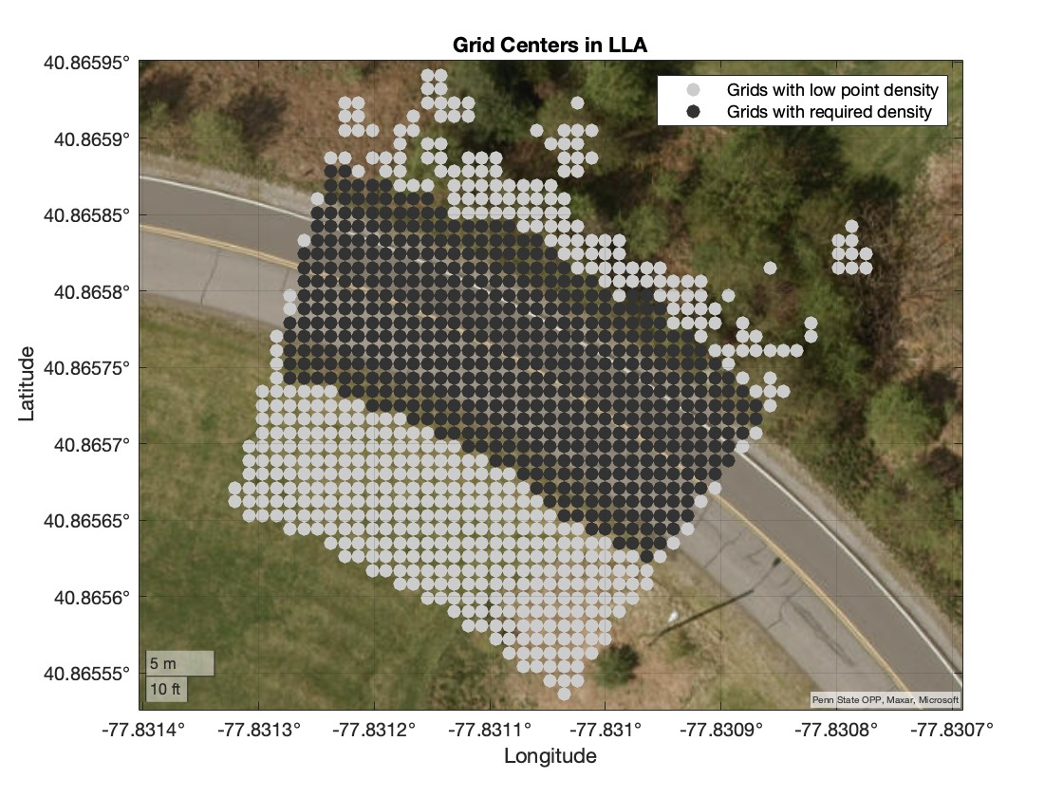
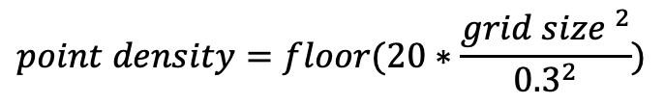
Grid Condition: Determine the point density (points per grid) by comparing the driven path densities with those of neighboring grids. This comparison has been done for multiple datasets with different grid sizes. In the current analysis, the grid size is chosen as 1 m. The RHS plot depicts the grids with the required point density and those with insufficient point density.
The orange and blue bins correspond to the point densities of the driven path and all the grids, respectively.
For plane fitting in the next steps, it was determined that each grid should contain at least 20 points when the grid size is 0.3 m (0.3 × 0.3). Therefore, this criterion has been extrapolated for other grid sizes as well.
The point density is calculated as:
$$point density=floor(20∗\frac{{grid size }^{2}}{{0.3}^{2}})$$

Slide 16
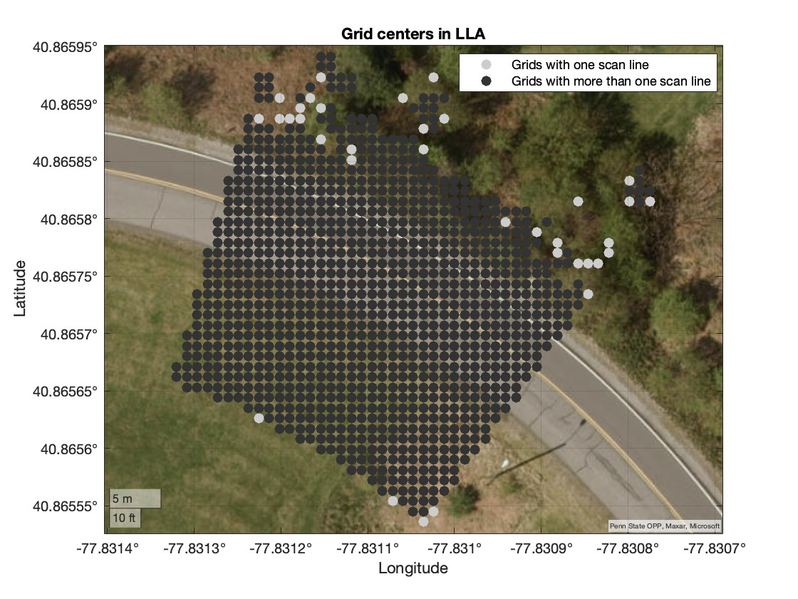
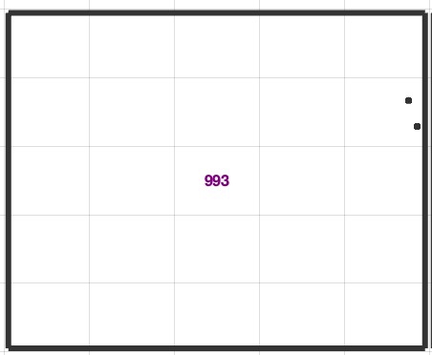
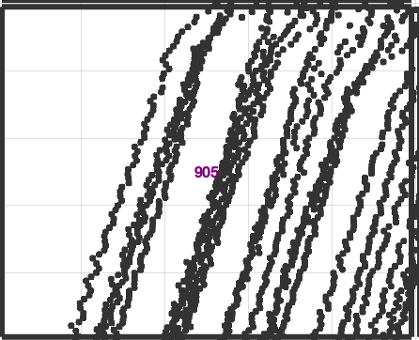
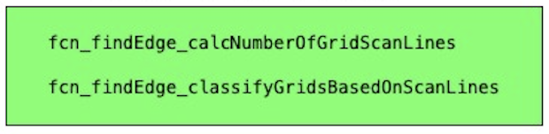
Grid Condition: Determine the number of scan lines in non-empty grids. Grids containing only one scan line cannot be used to fit a plane, as the angle deviation in these grids is high and they are automatically classified as uncertain grids (neither drivable nor non-drivable). To reduce the number of uncertain grids, these grids are identified and dropped from further analysis. Fitting a plane and angle deviation are discussed in the following slides.
Grids with one scan line
Grids with more than one scan line

Slide 17
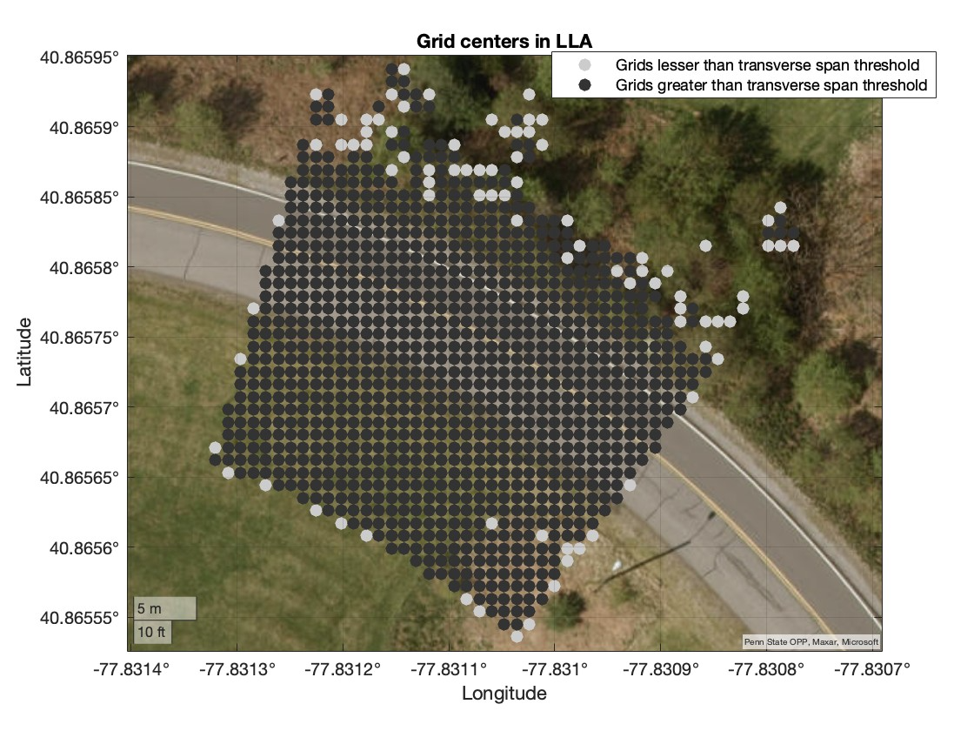
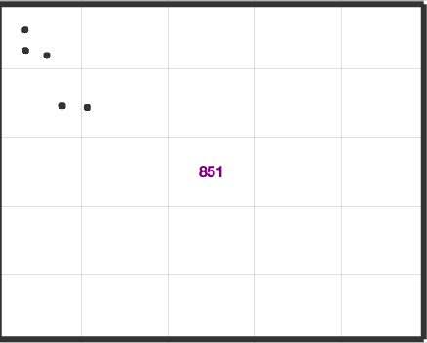
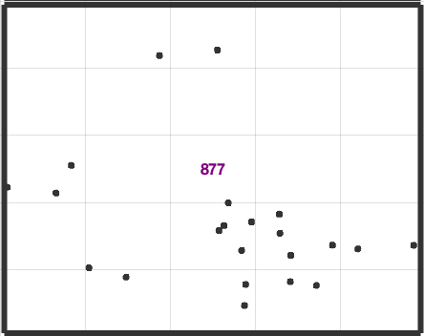
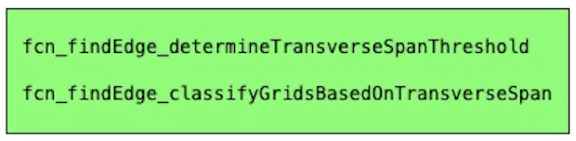
Grid Condition: Sometimes, grids containing more than one scan line may still be classified as uncertain (as discussed in later slides) due to the overlapping of scan lines within the grid. It has been found that the maximum span distance of each grid should be at least 0.15 meters, based on an analysis of various locations and grid sizes.
Maximum span distance of this grid < 0.15m
Maximum span distance of this grid > 0.15m

Slide 18
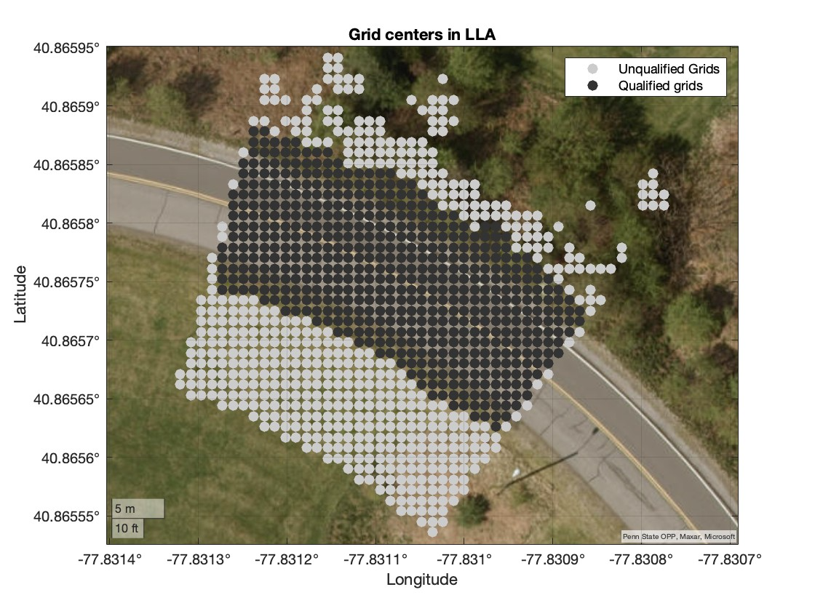
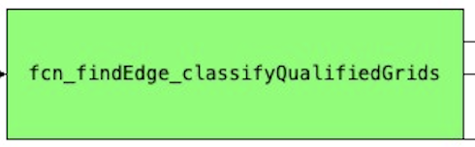
Grids that contain sufficient point density, have more than one scan line, and meet the maximum span distance are classified as qualified grids. The remaining grids are classified as unqualified and are dropped from further analysis.

Slide 19
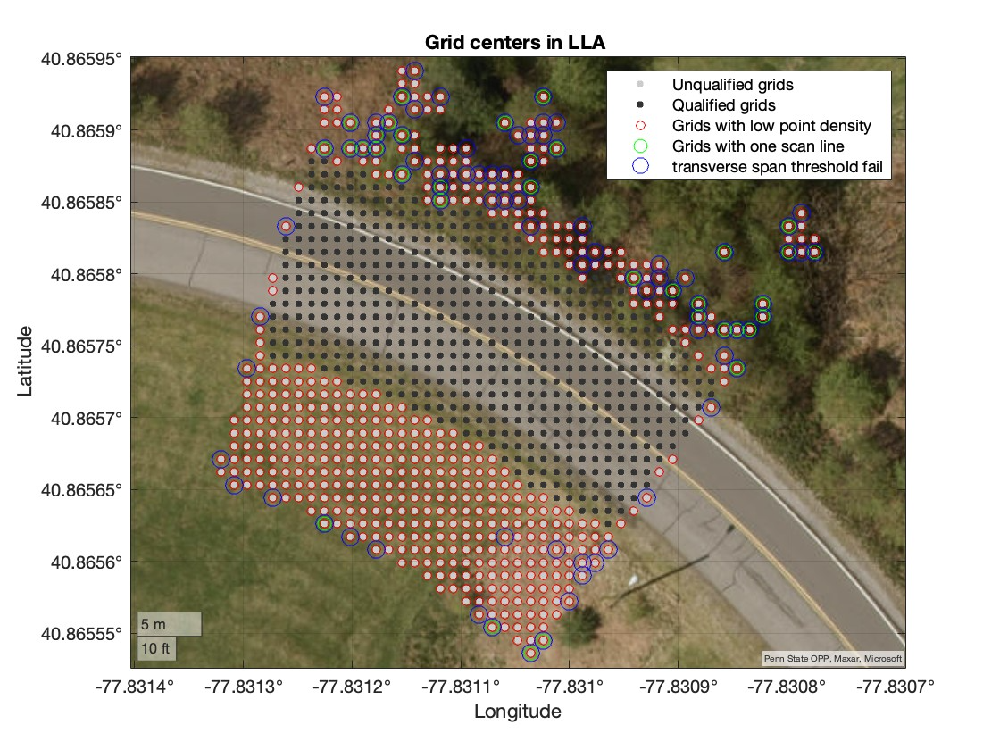
The failed conditions of unqualified grids are highlighted with different color circles.

Slide 20
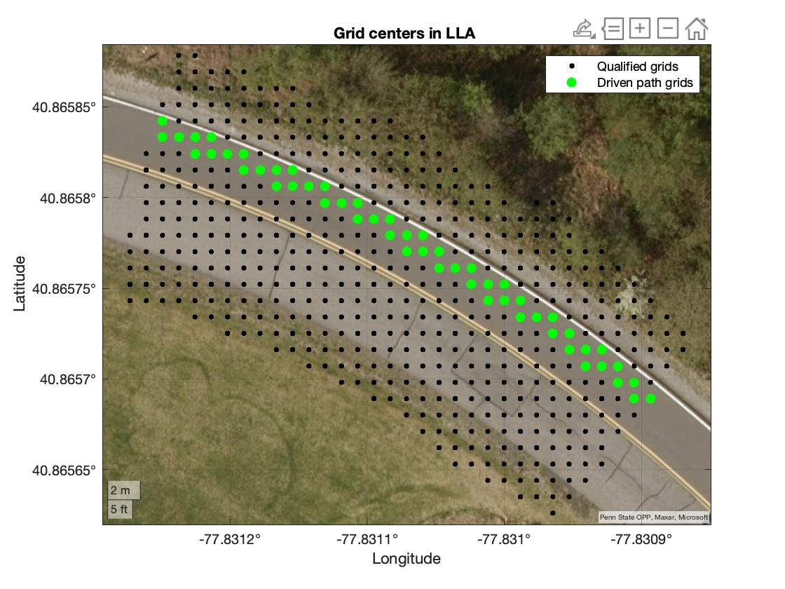
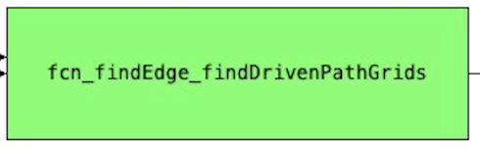
Recalculate the driven path grids from the qualified grids for further analysis.

Slide 21
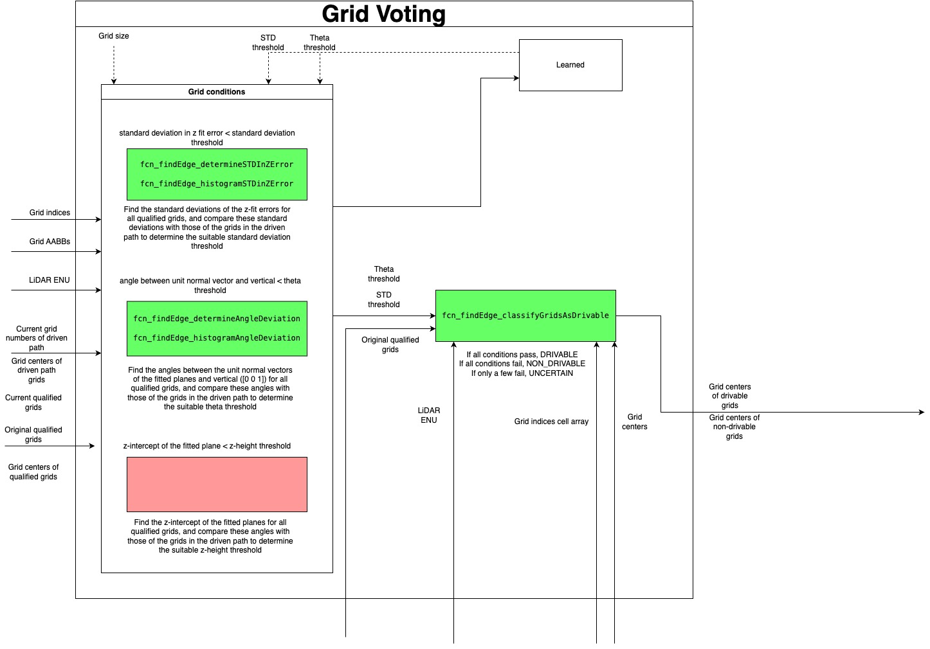
Grid Voting

Slide 22
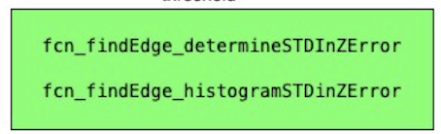
Plane fitting of a driven path grid (standard deviation in z-error = 0.02 m and angle deviation = 5.03 degrees) and a grid with a standard deviation of 0.12 m, with an angle deviation (the angle between the green and unit vector of [0 0 1]) ) of 3.2 degrees.

Slide 23
Grid Condition: Find the standard deviations of the z-errors for all qualified grids by fitting a plane and compare these standard deviations with those of the grids in the driven path to determine a suitable standard deviation threshold. This comparison has been done for multiple datasets with the same grid size.
The standard deviations enclosed in green circles are the standard deviations of the driven path
The orange and blue bins correspond to the standard deviations of the driven path and all the grids, respectively.
Initially, the standard deviation threshold is selected by choosing 3-5 standard deviations above the mean of the standard deviations of the driven path grids. Later, the threshold is slightly adjusted manually to find the most suitable value.

Slide 24
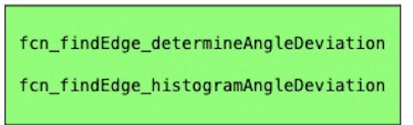
Plane fitting of a driven path grid (standard deviation in z-error = 0.02 m and angle deviation = 5.03 degrees) and a grid with a standard deviation of 0.07 m, with an angle deviation of 10.29 degrees (the angle between the green vector and the unit vector [0 0 1]).

Slide 25
Grid Condition: Find the angles between the unit normal vectors of the fitted planes and the vertical vector ([0 0 1]) for qualified grids and compare these angles with those of the grids in the driven path to determine a suitable theta threshold. This comparison has been conducted for multiple datasets with the same grid size.
The angle deviations enclosed in green circles are the angle deviations of the driven path.
The orange and blue bins correspond to the angle deviations of the driven path and all the grids, respectively.
Initially, the angle deviation threshold is selected by choosing 3 standard deviations above the mean of the angle deviations of the driven path grids. Later, the threshold is slightly adjusted manually to find the most suitable value.

Slide 26
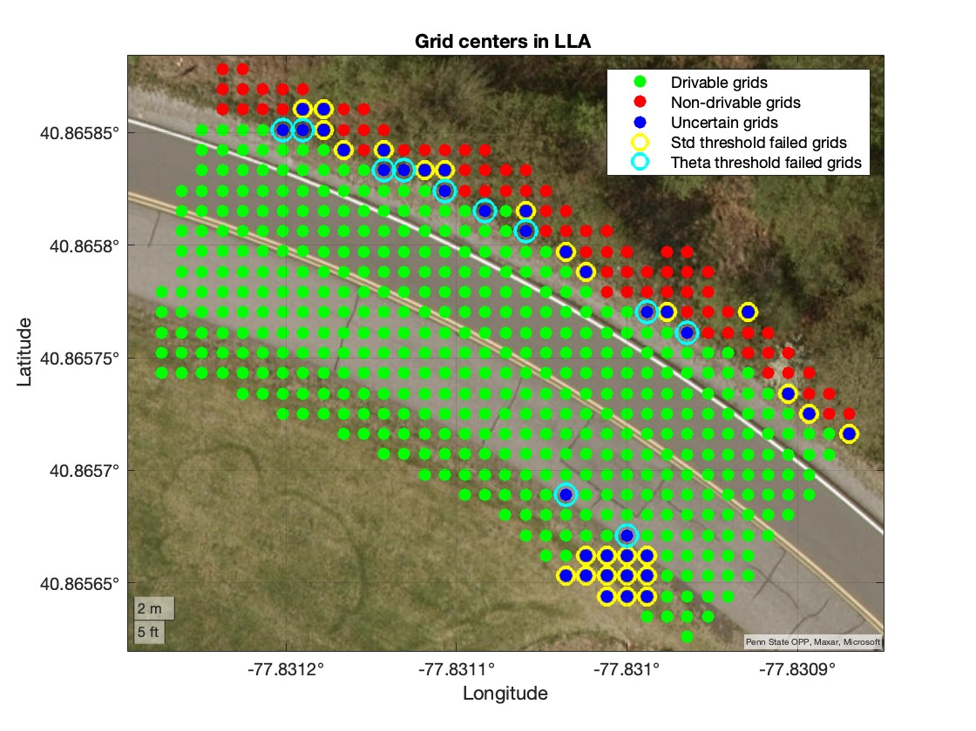
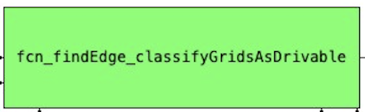
Voting: The qualified grids are classified as drivable, non-drivable, and uncertain grids.

Slide 27
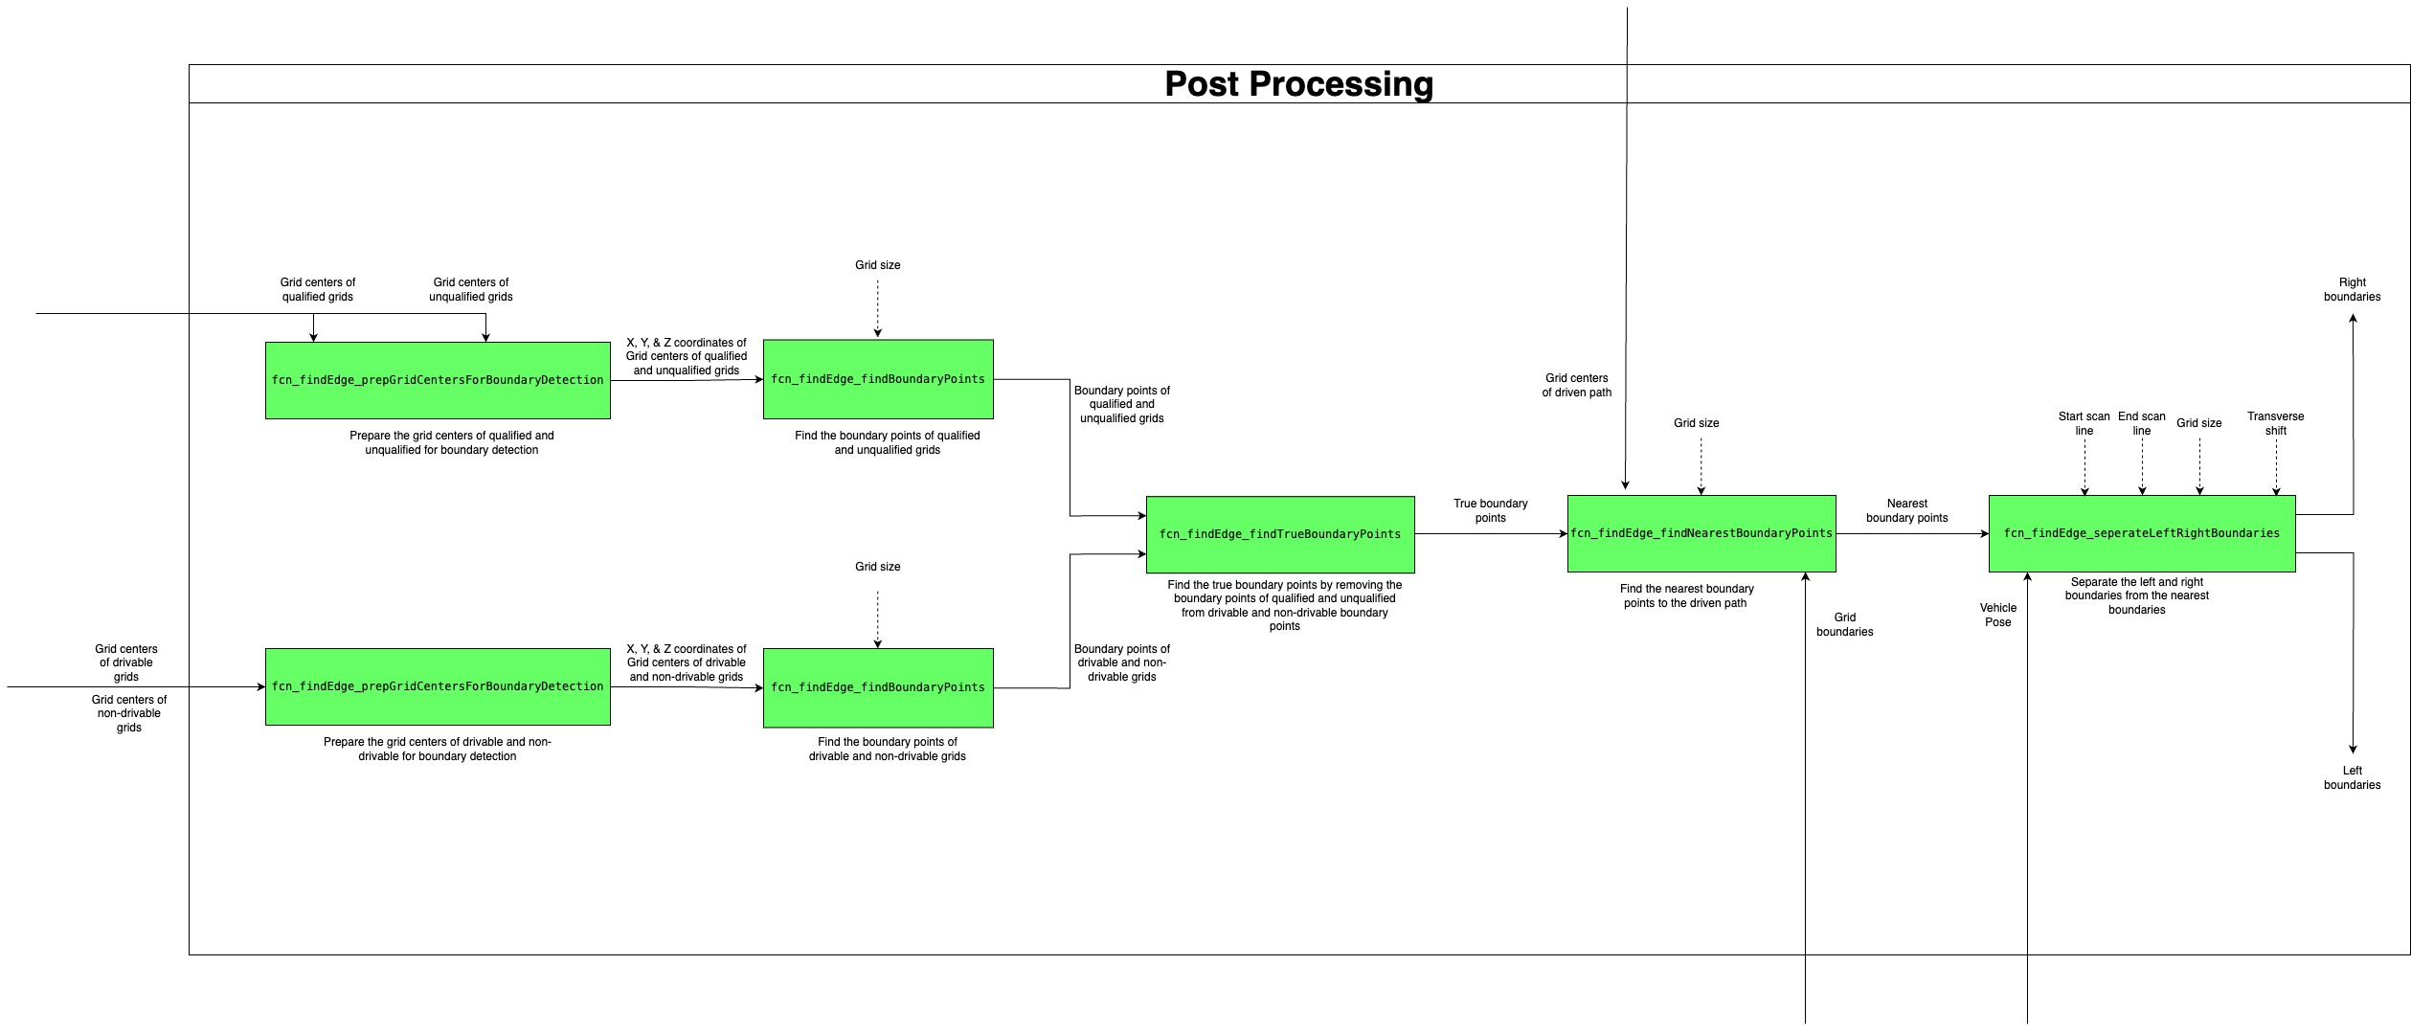
Post Processing

Slide 28
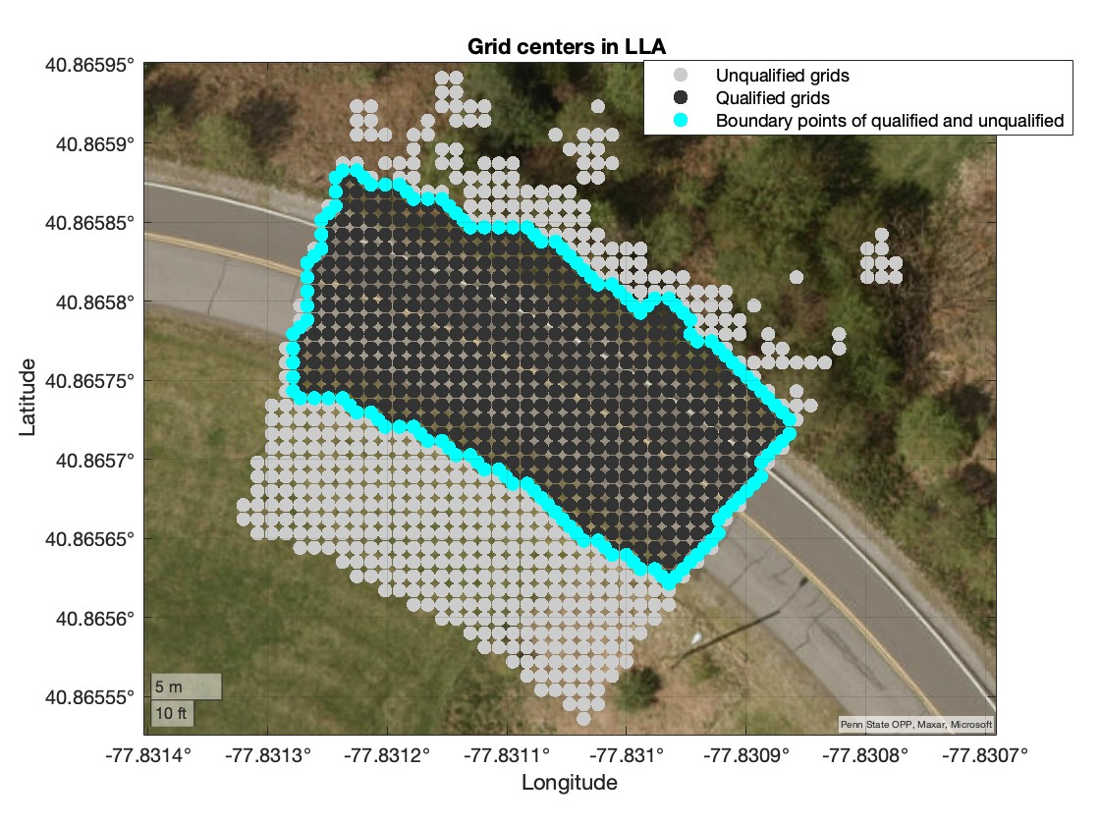
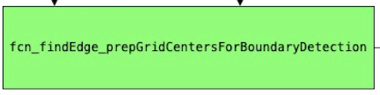
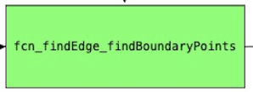
The boundary points of qualified and unqualified grids

Slide 29
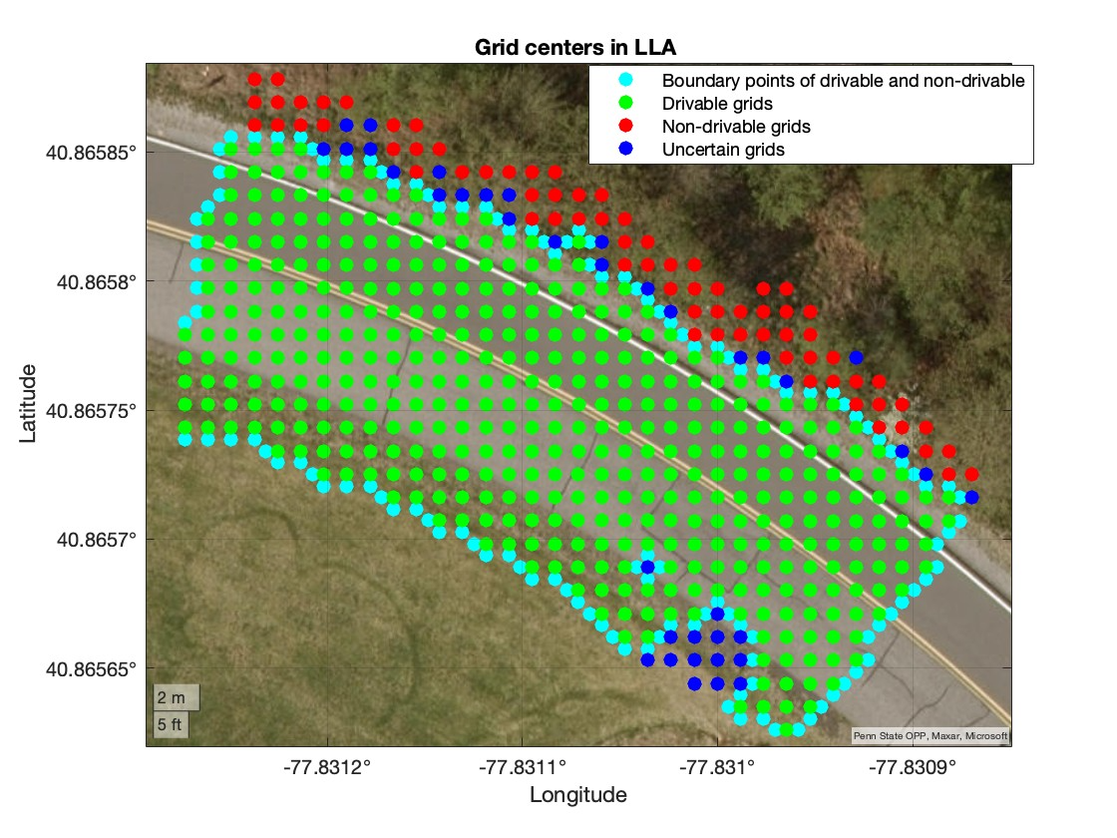
The boundary points of drivable and non-drivable grids

Slide 30


The boundary points of qualified and unqualified are removed from the boundary points of drivable and non-drivable to find the true boundary points

Slide 31


The nearest boundary points are computed from the true boundary points

Slide 32



The nearest boundary points are separated into left and right boundary points. The right boundary points separate the pavement from the vegetation

